Slide 1
Music@Home Figures

Slide 2
Study 1 Validity
eBMRQ
GoldMSI

Slide 3
Study 2 Validity
GoldMSI
BMRQ

Slide 4
Study 2 Validity
Adversity

Slide 5
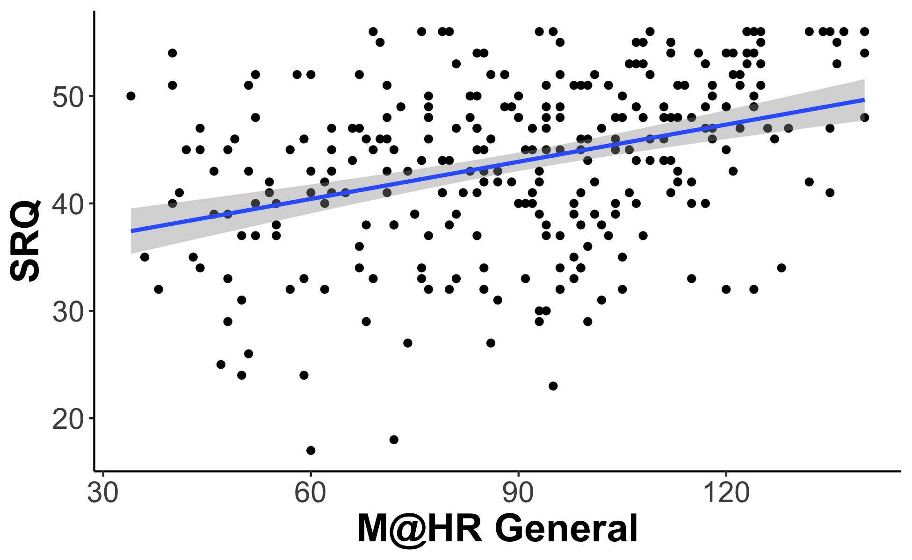
Study 2 Validity
SRQ

Slide 6
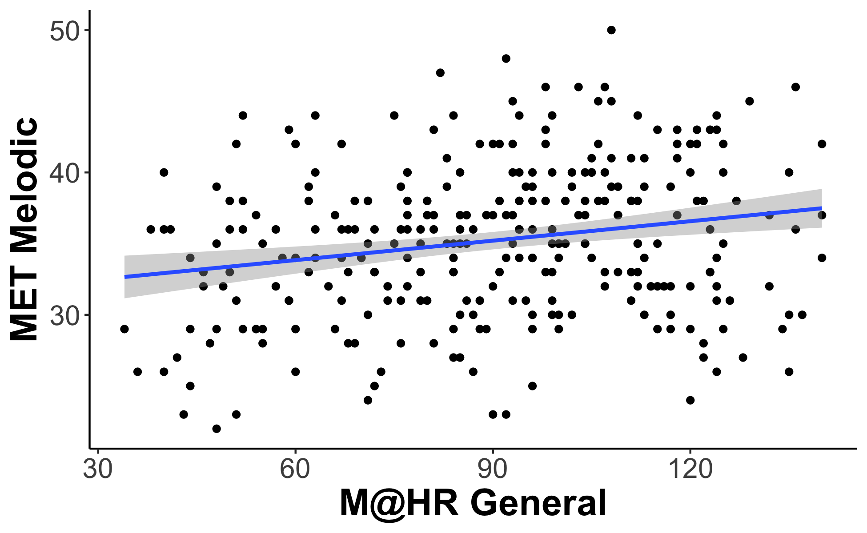
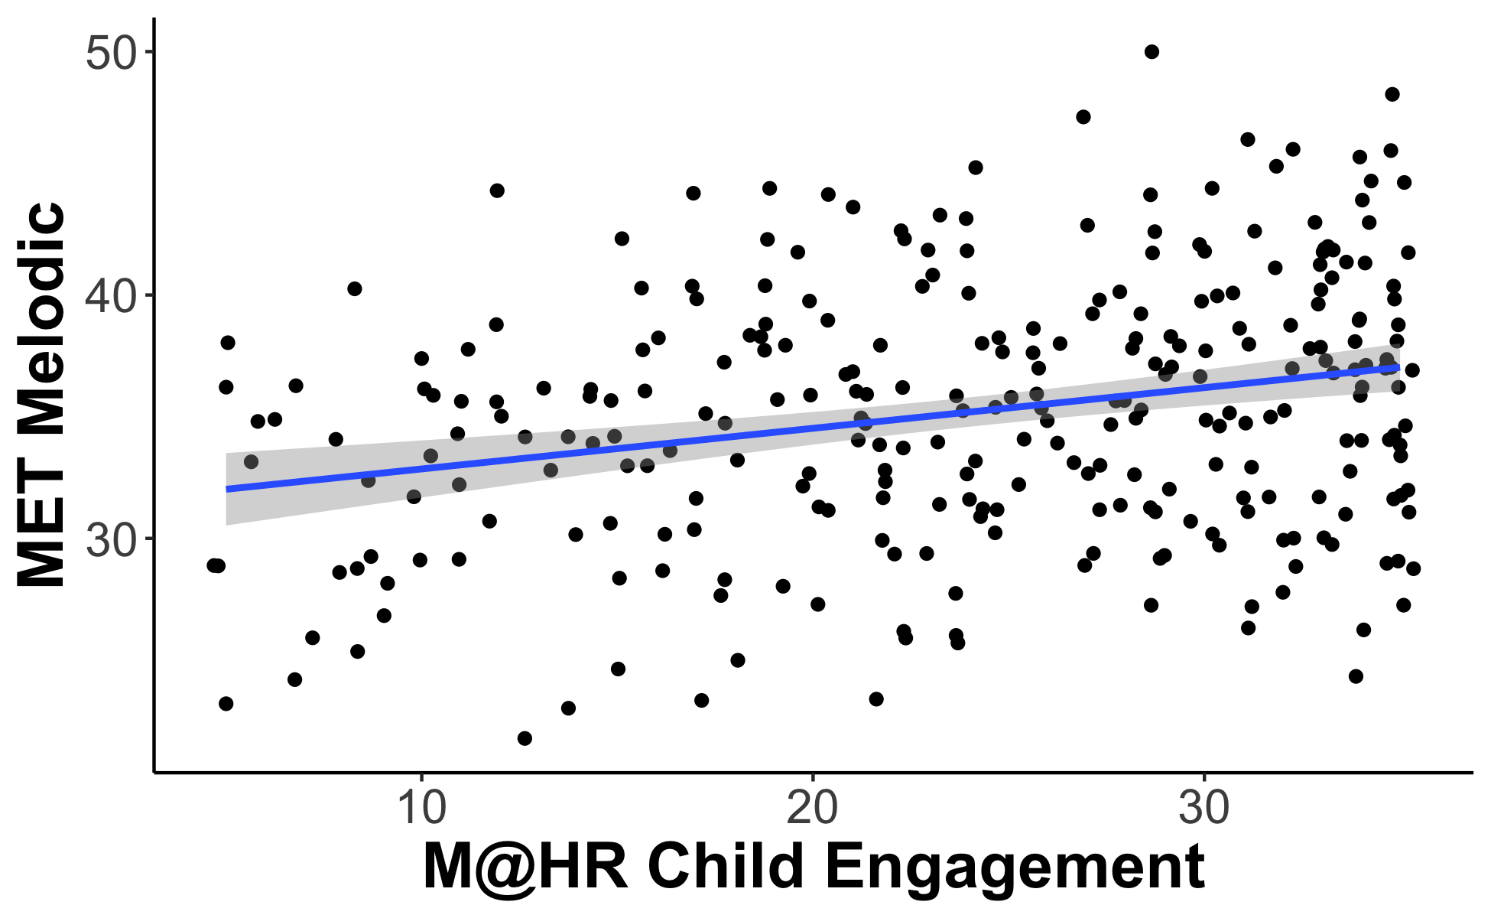
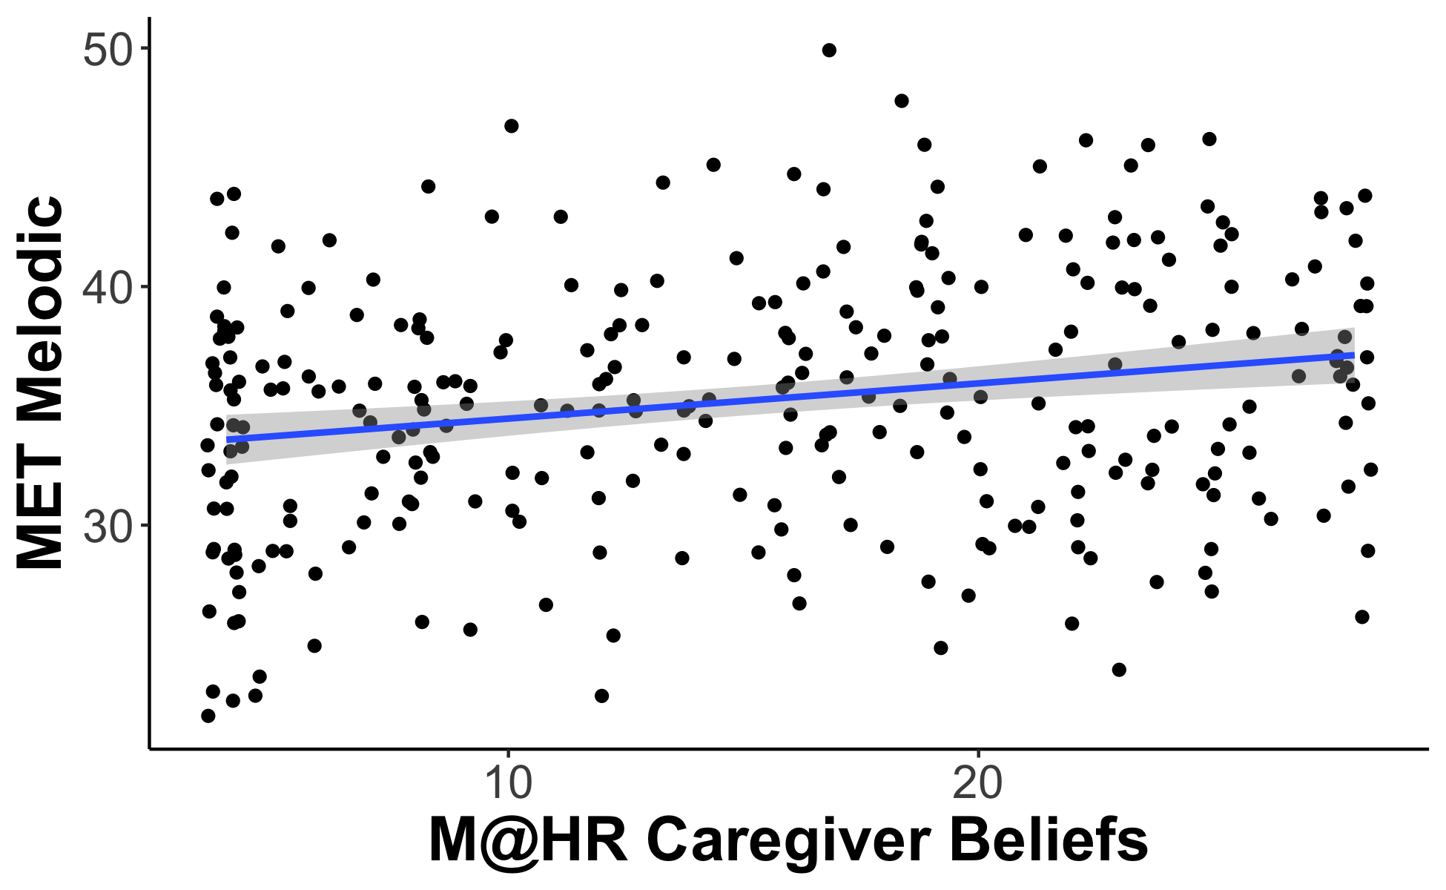
Utility of Scale: MET

Slide 7
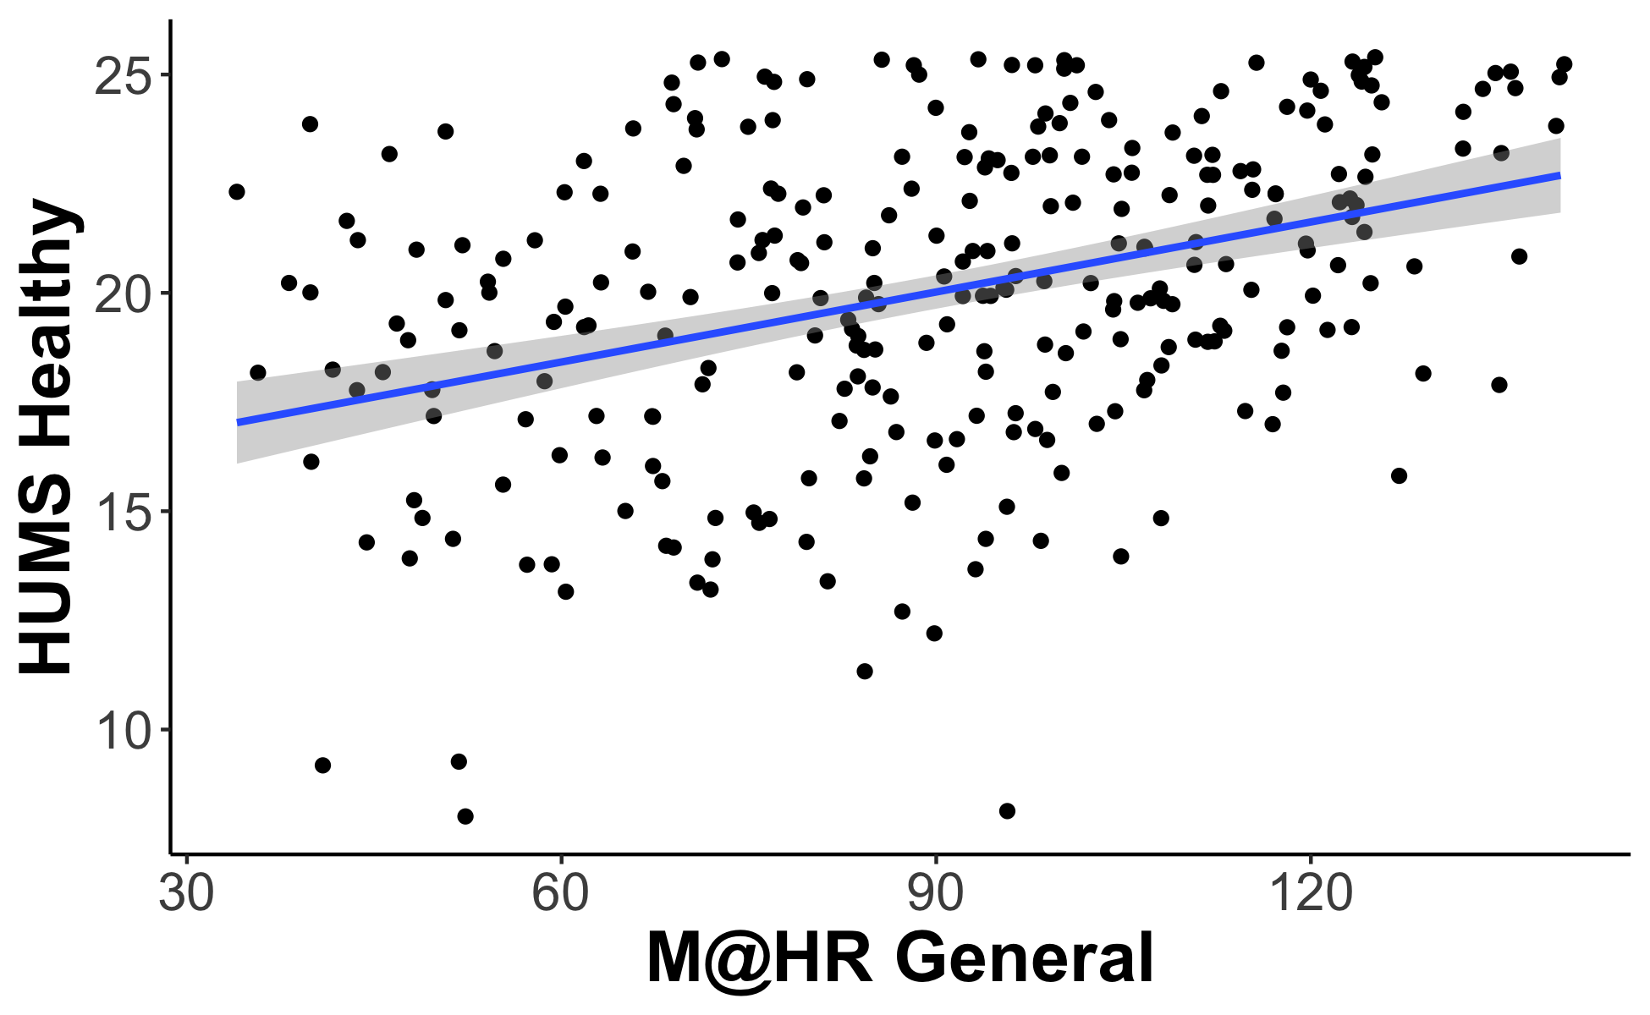
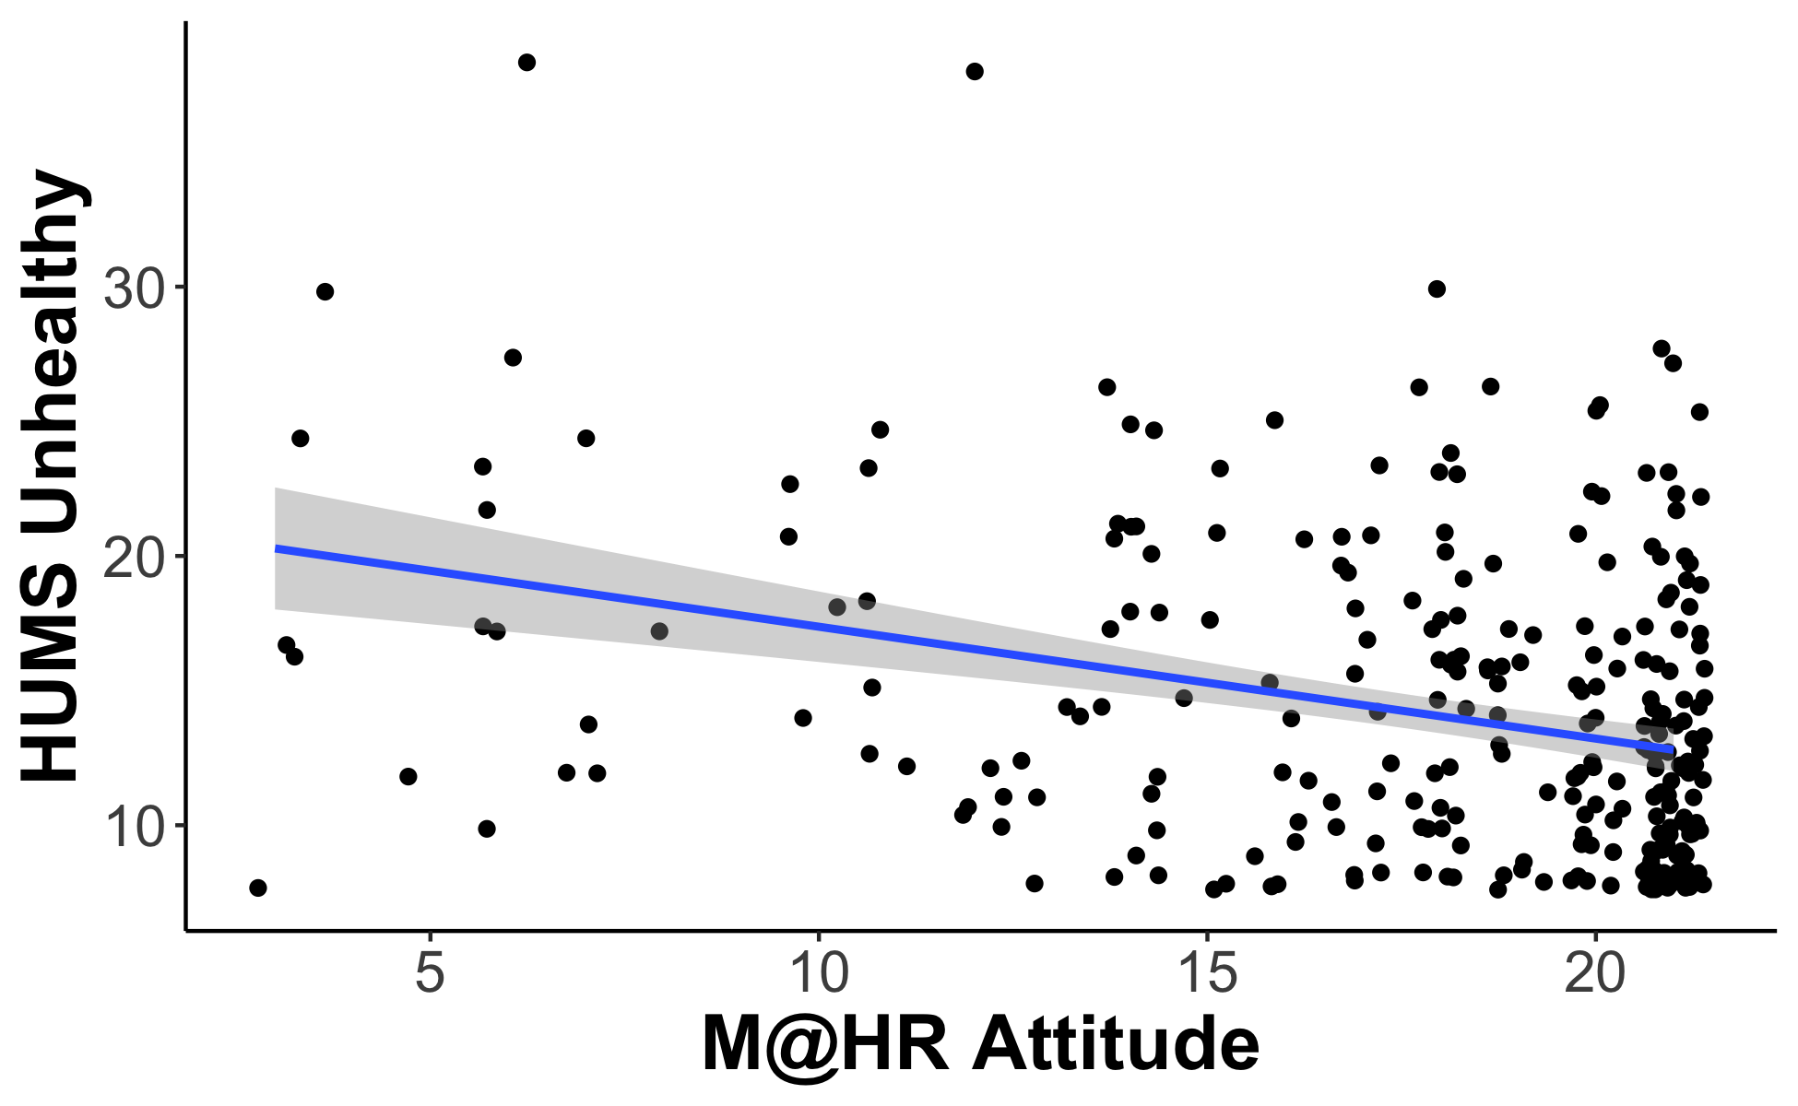
Utility of Scale: HUMS

Slide 8
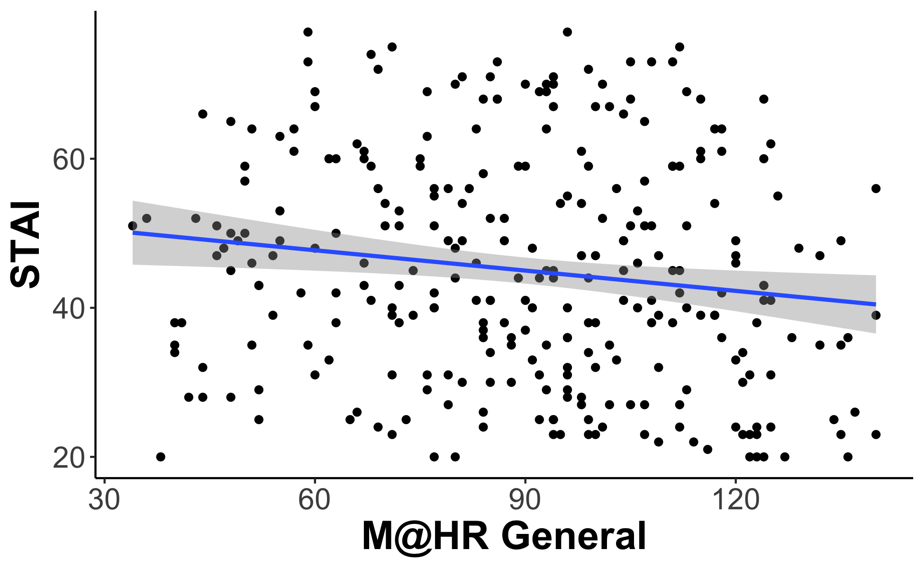
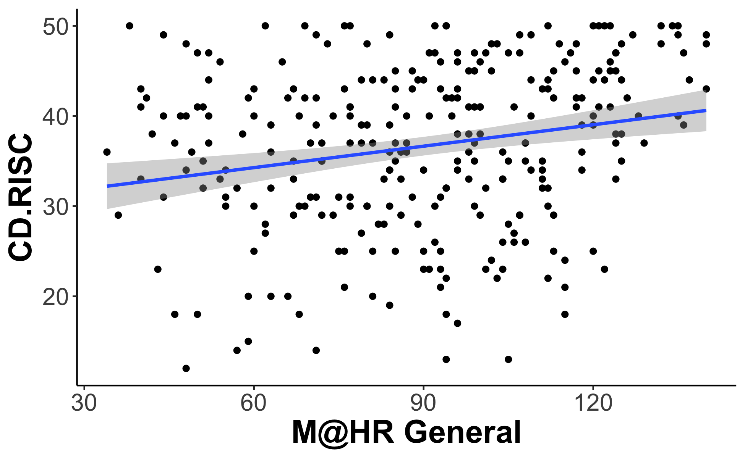
Utility of Scale: Mental Health

Slide 9
Updated Figures
Since 10/2 Meeting

Slide 10
Table 2: GoldMSI and M@H-R

Slide 11
Table 3: eBMRQ and M@H-R

Slide 12
Table 4: Adversity and M@H-R

Slide 13
Table 6: SRQ and M@H-R

Slide 14
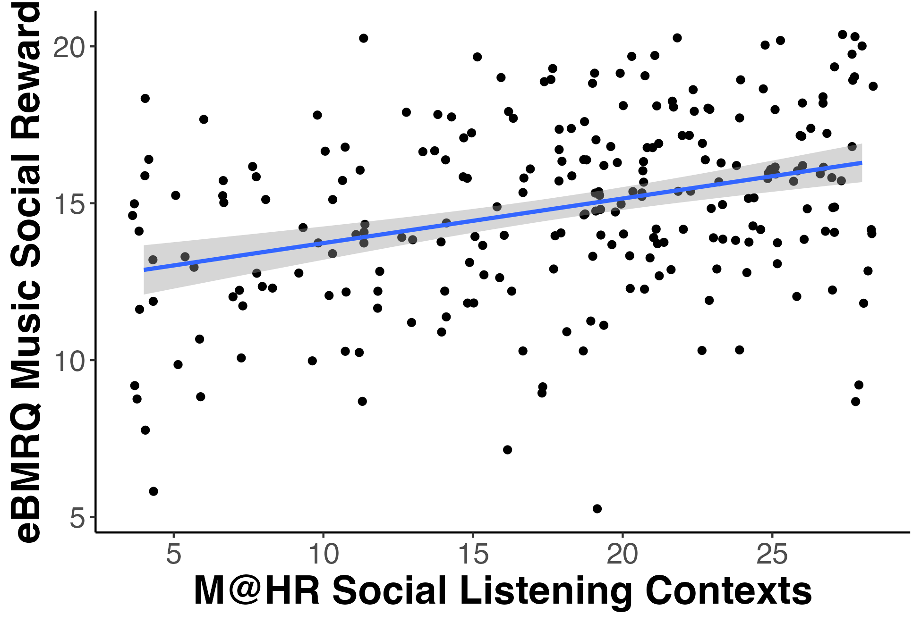
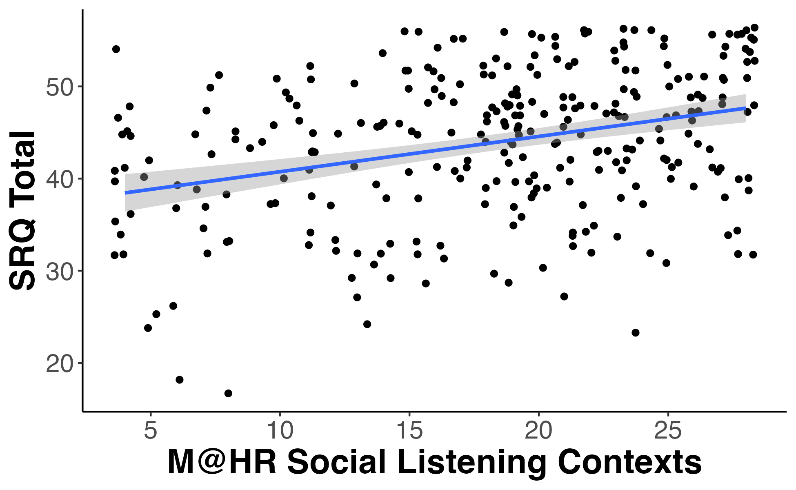
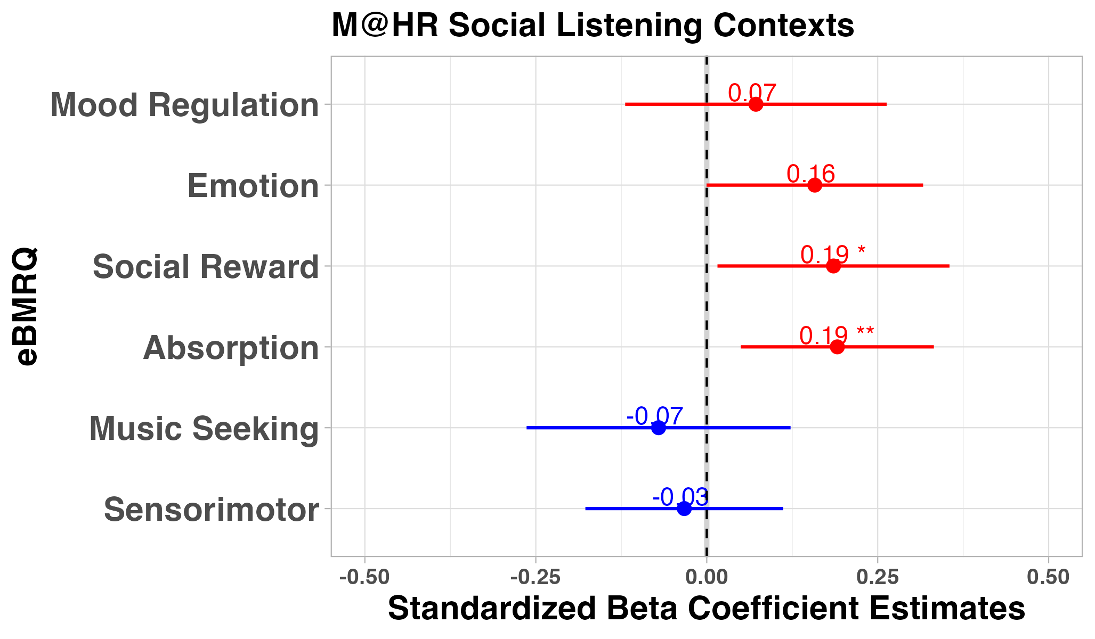
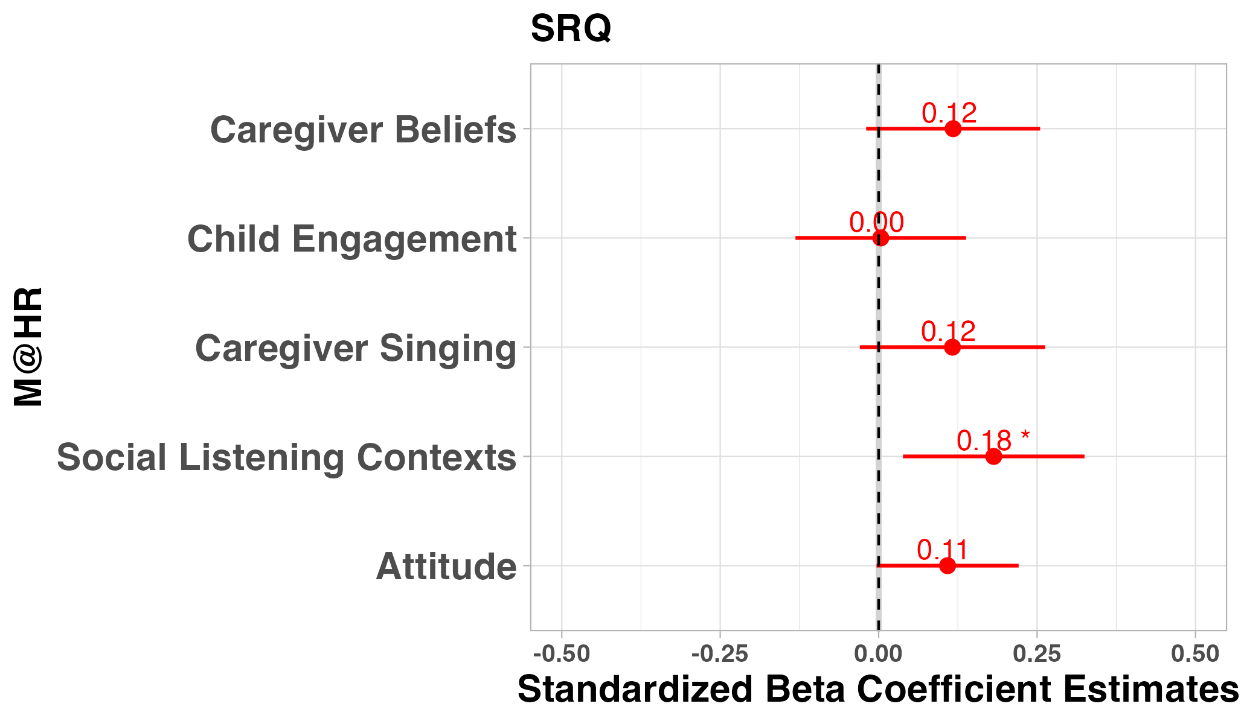
Figure 2: Social Scatters
A.
B.
r = .34***
r = .33***
C.
D.

Slide 15
Table 7: Test-Retest ICC

Slide 16
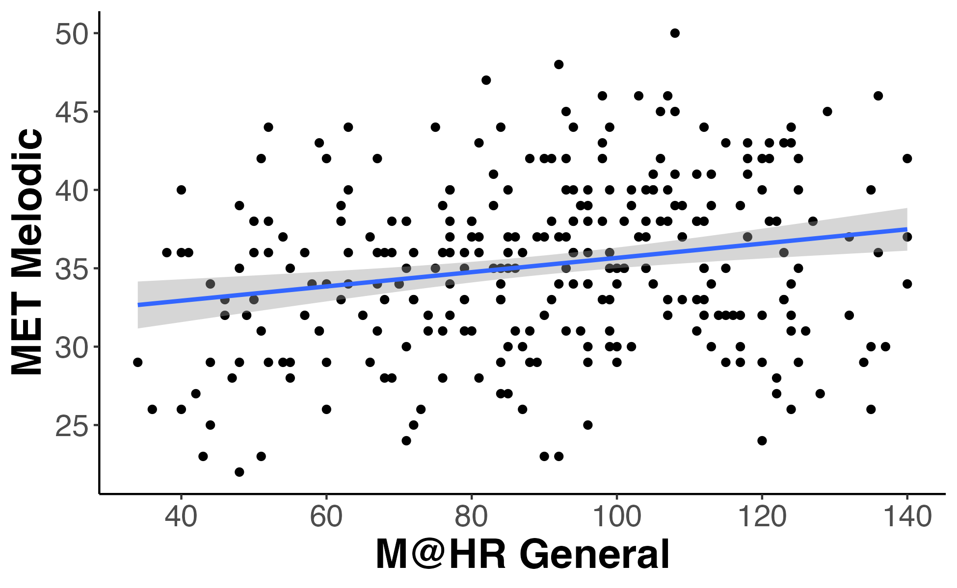
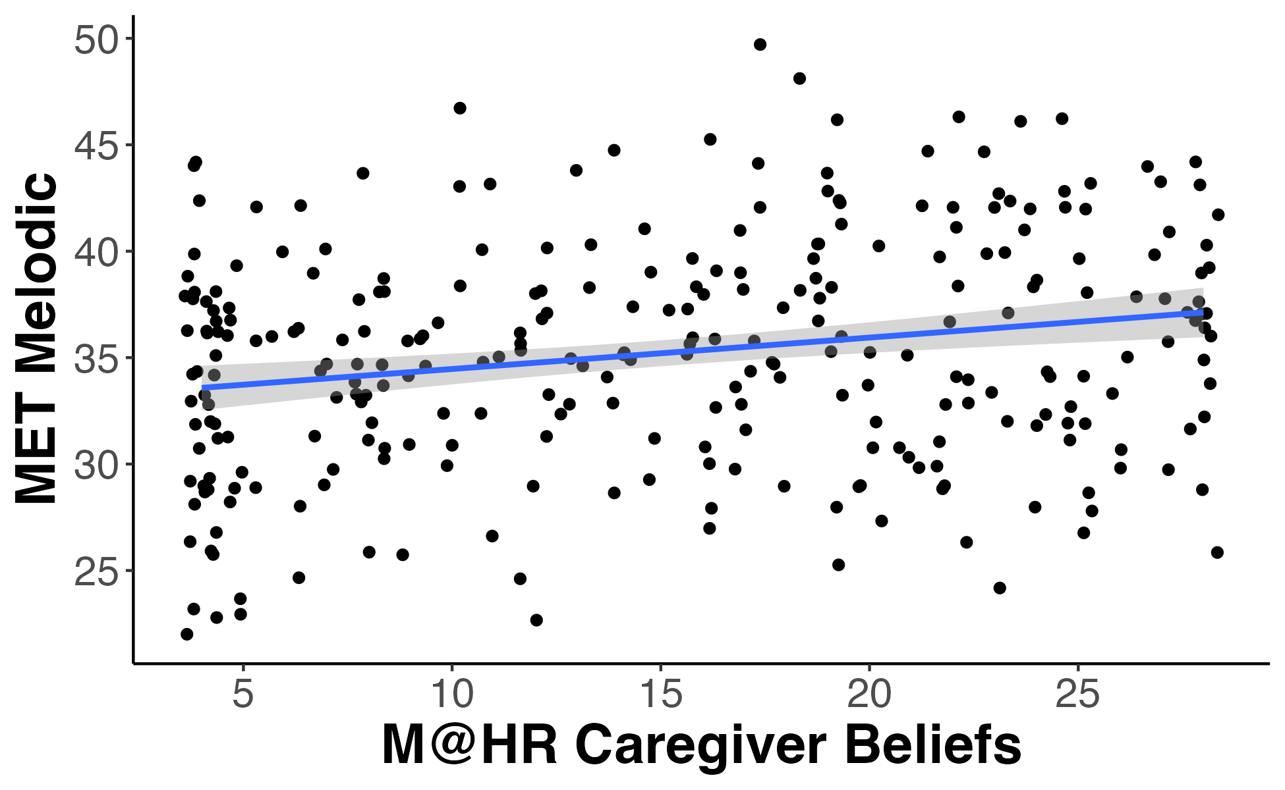
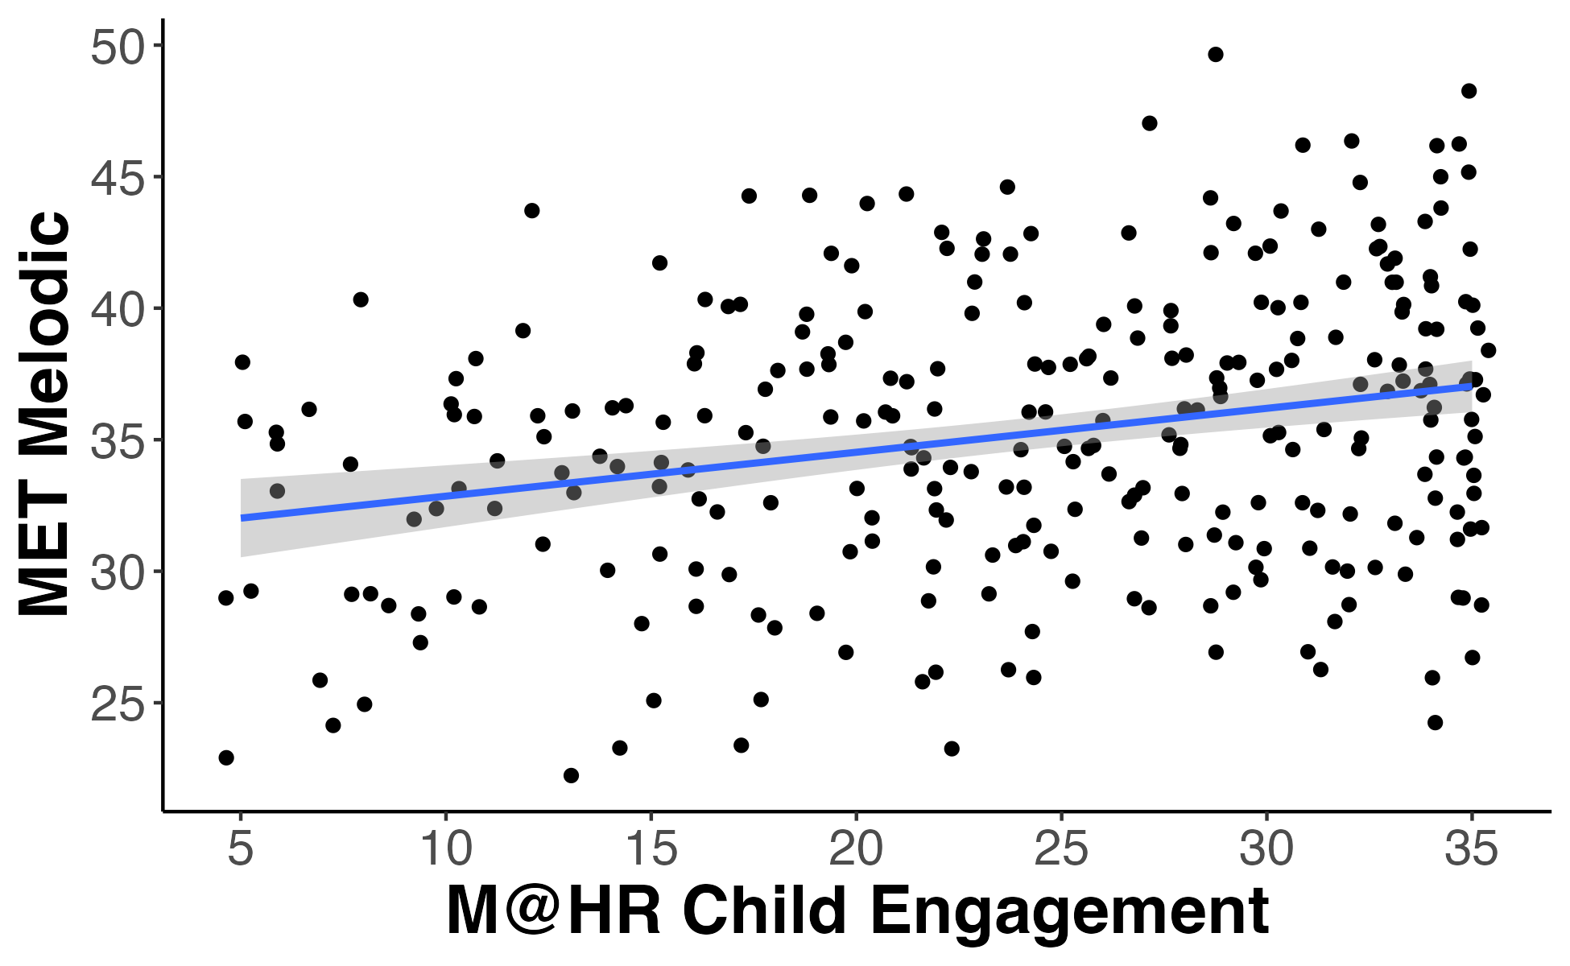
Figure 3: MET
A.
B.
C.
r = .21***
r = .22***
r = .26***

Slide 17
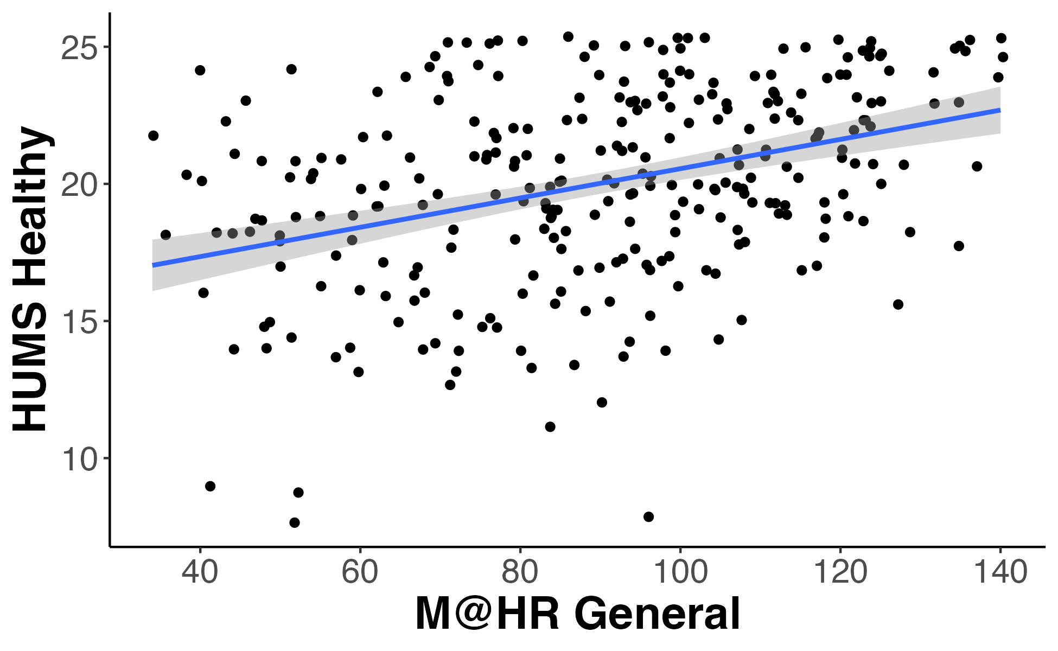
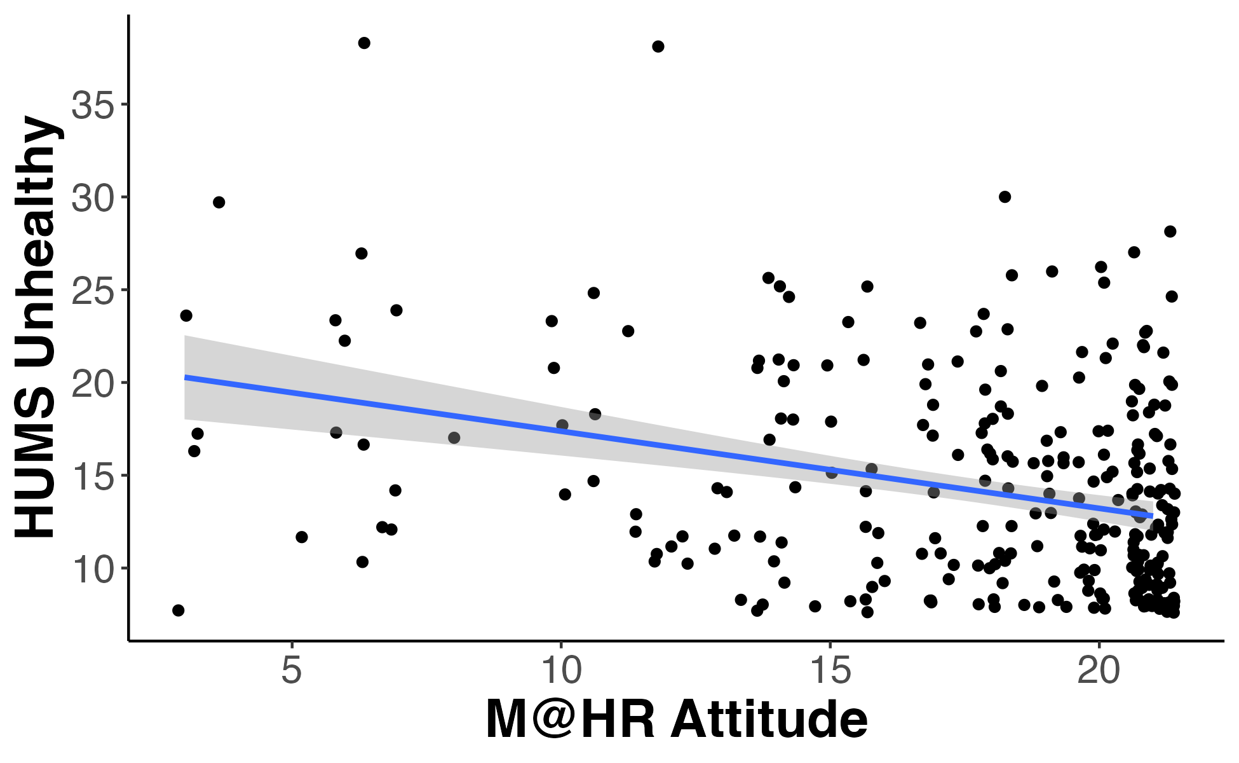
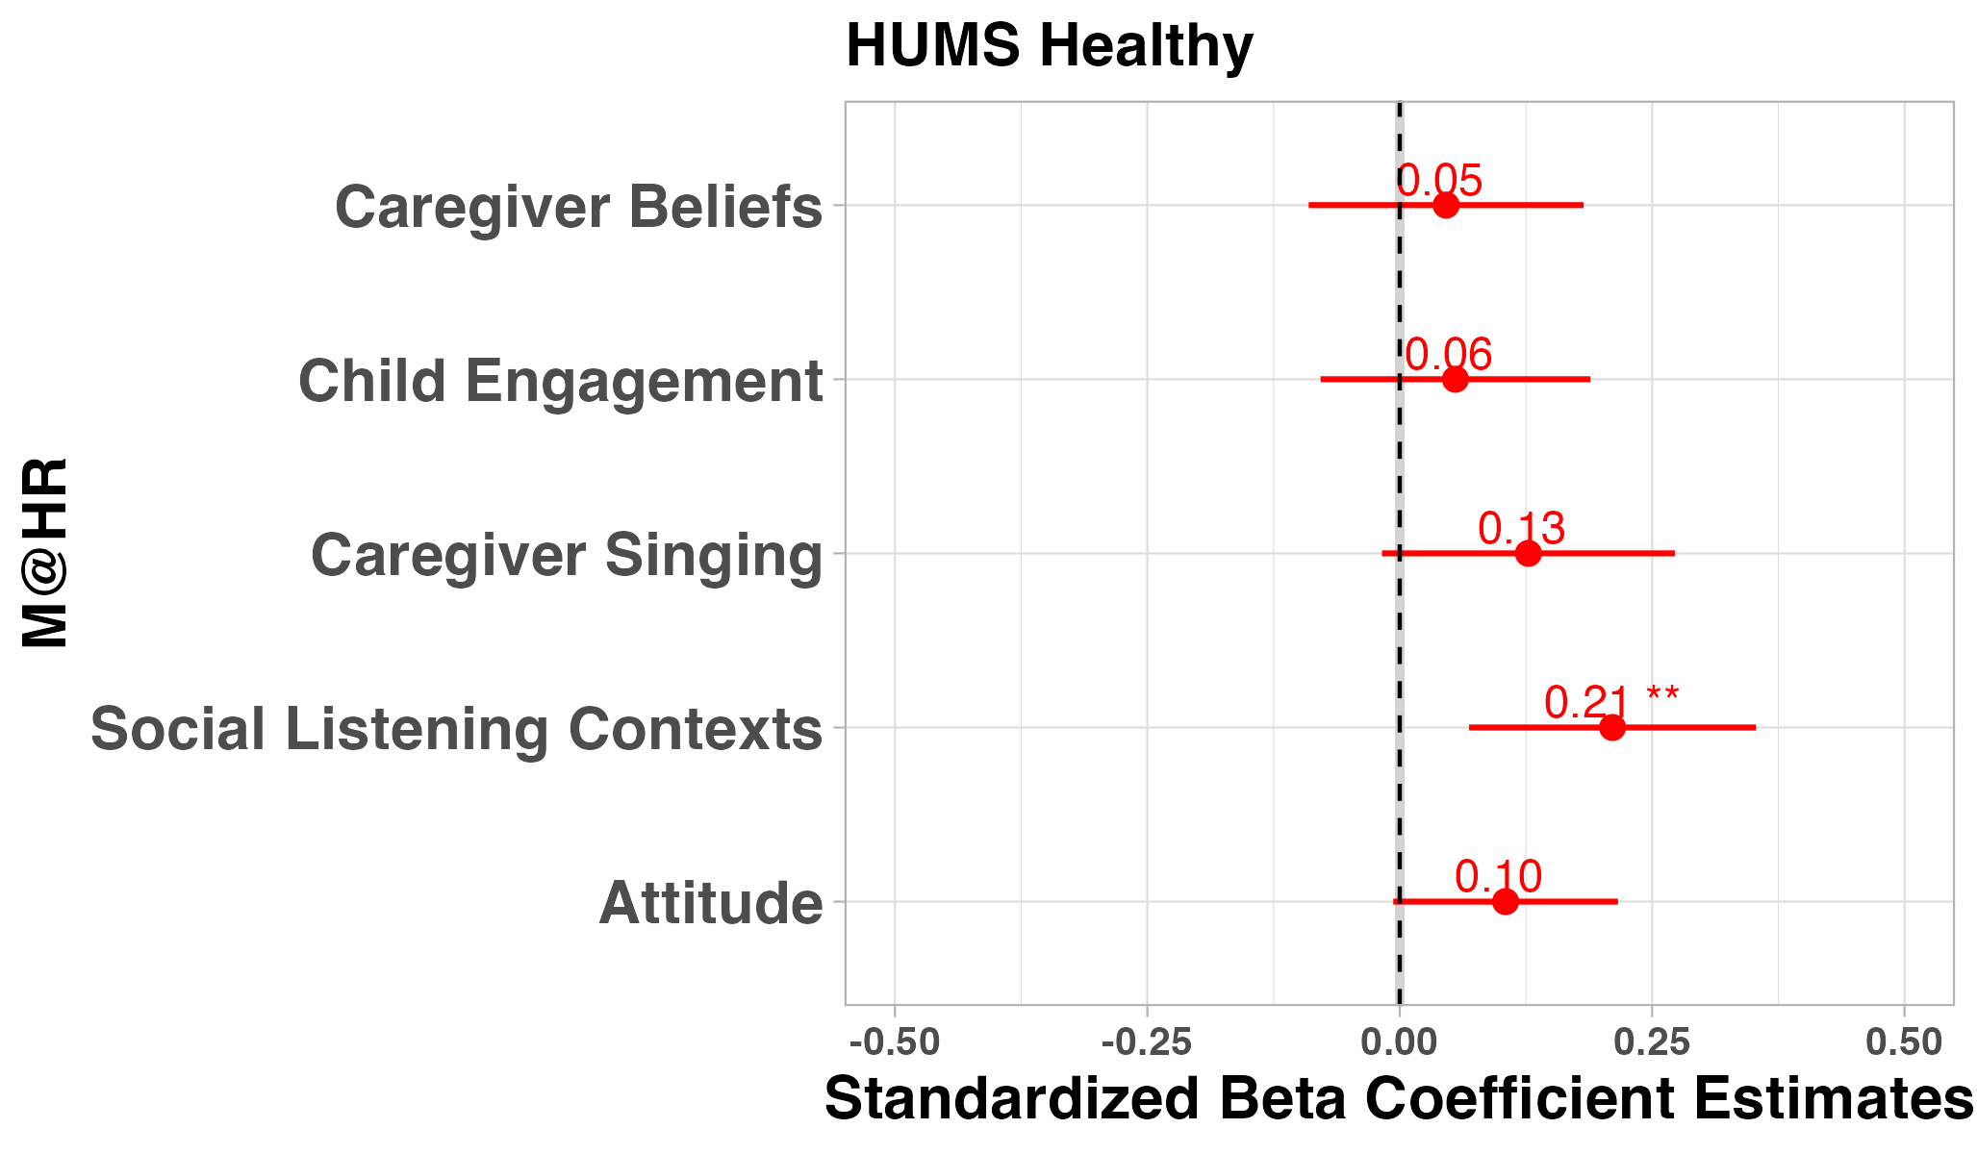
Figure 4: HUMS
A.
B.
C.
r = .38***
r = -.31***

Slide 18
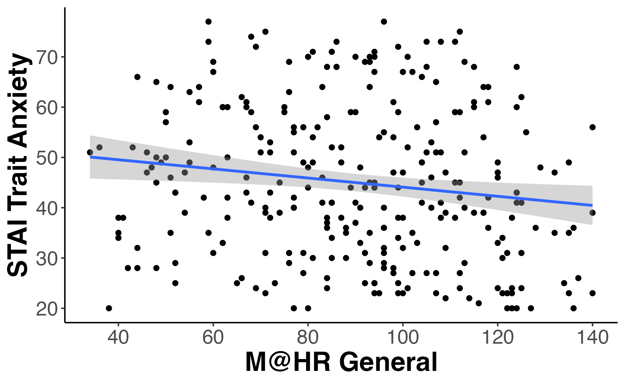
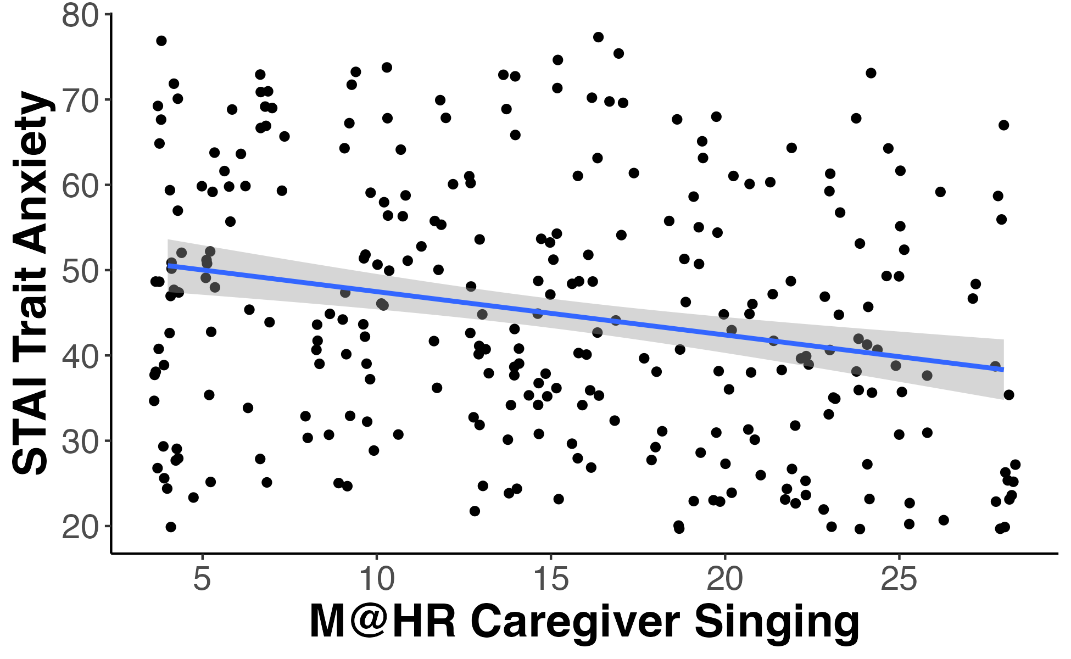
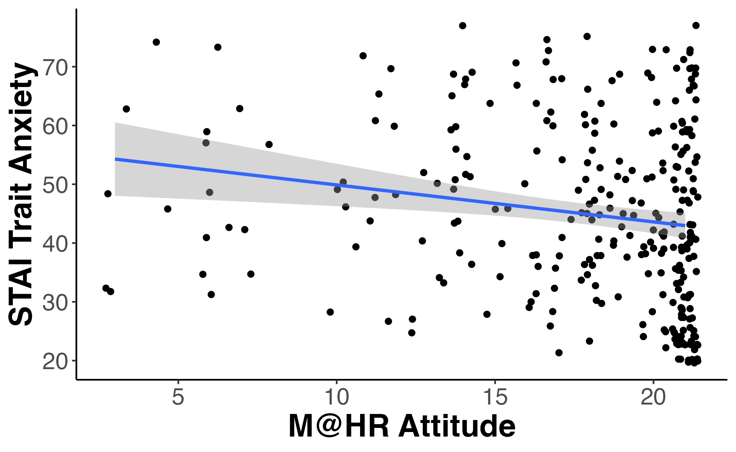
Figure 5: STAI
A.
B.
C.
r = -.15*
r = -.24***
r = -.18**

Slide 19
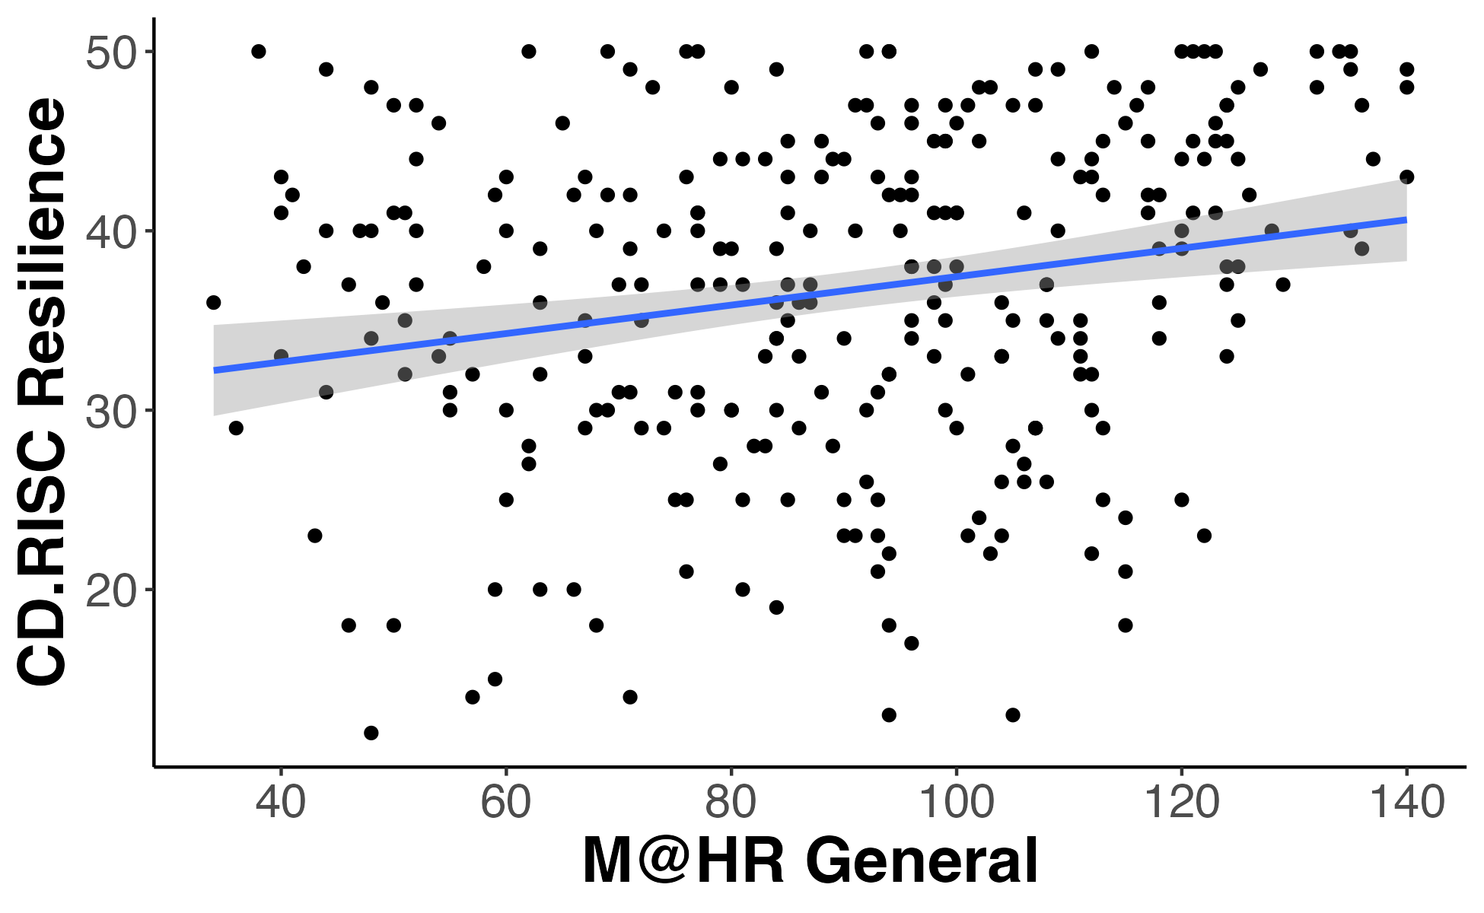
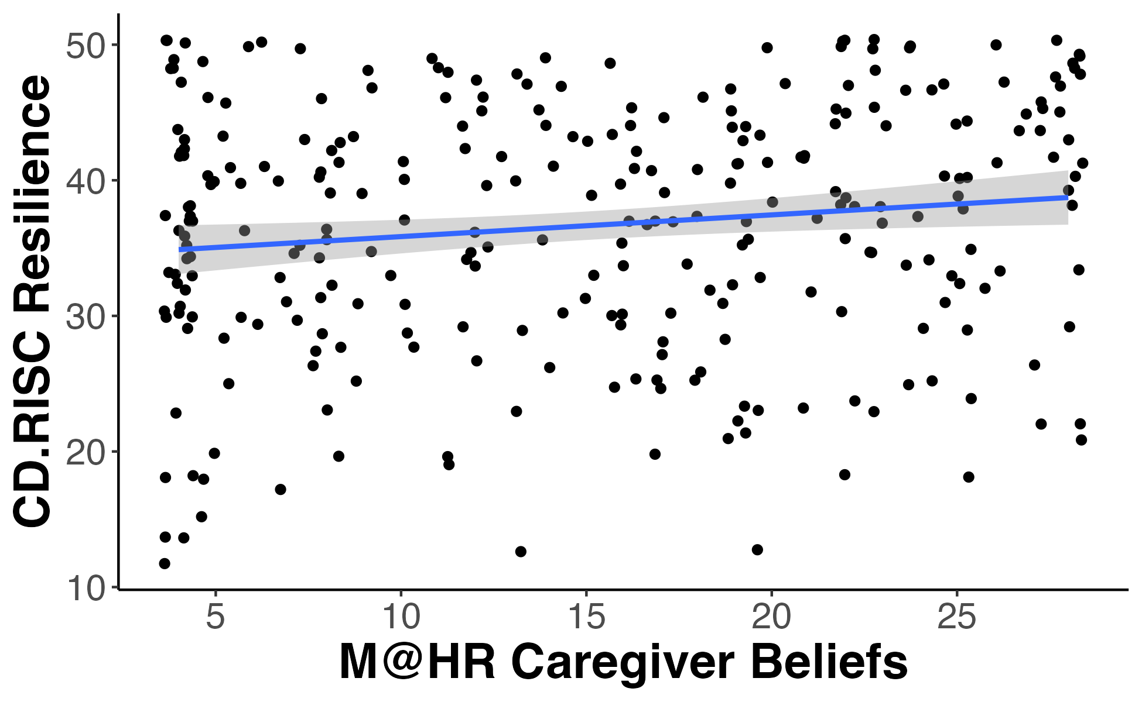
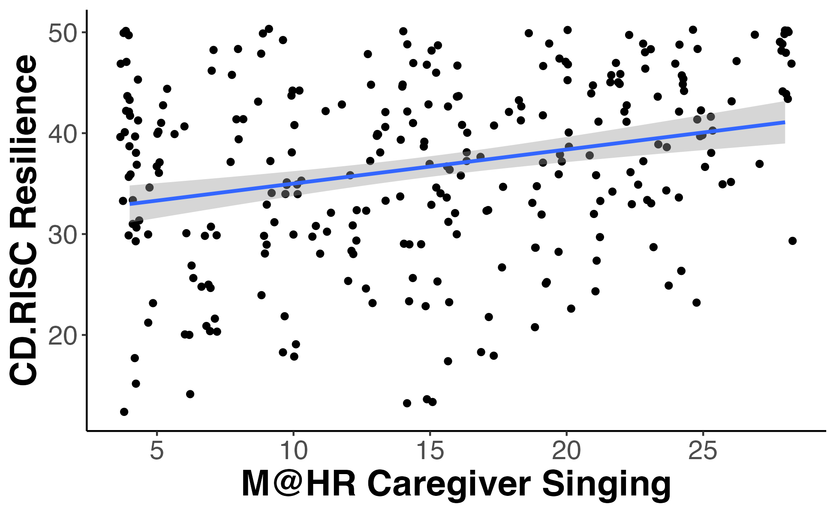
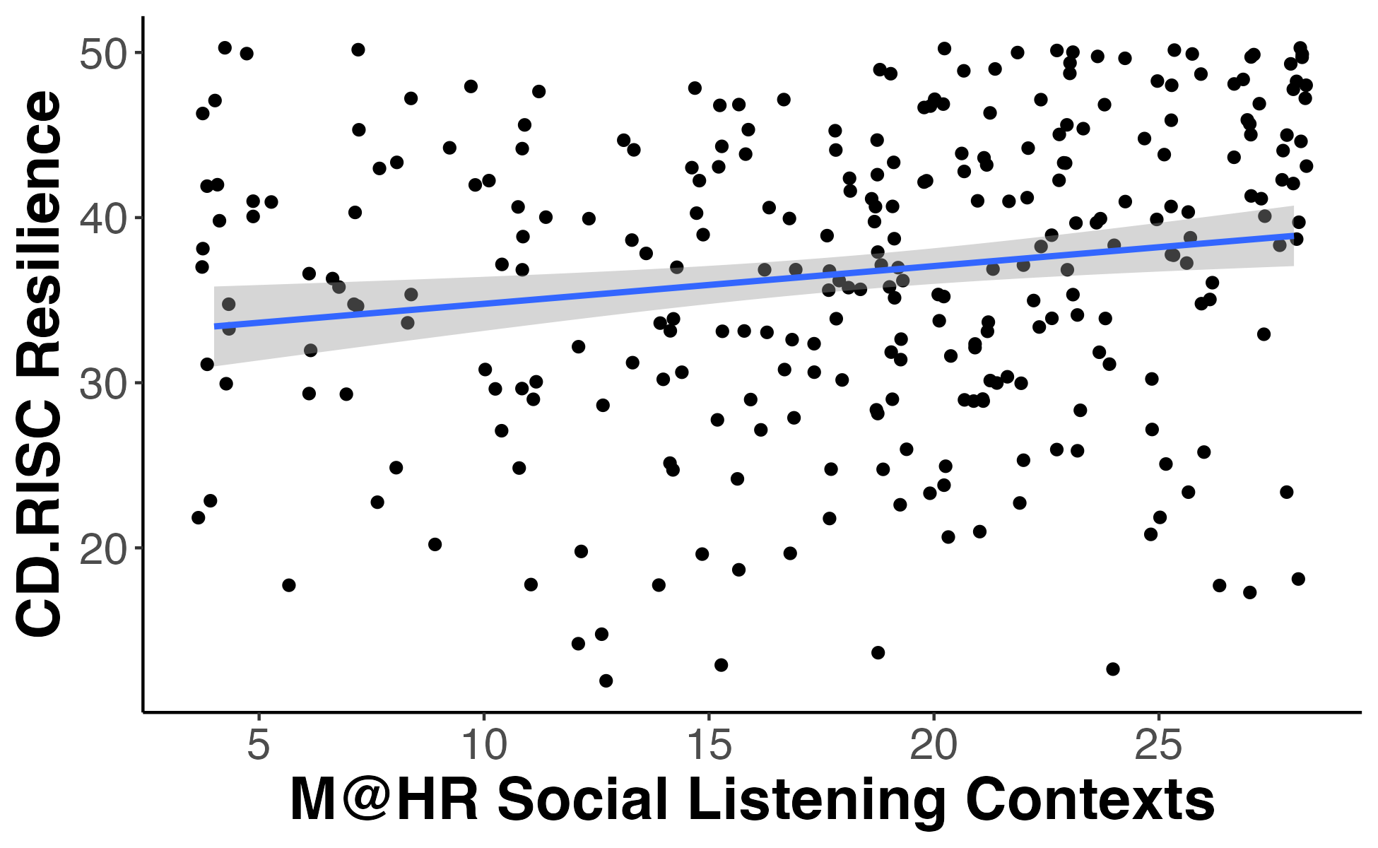
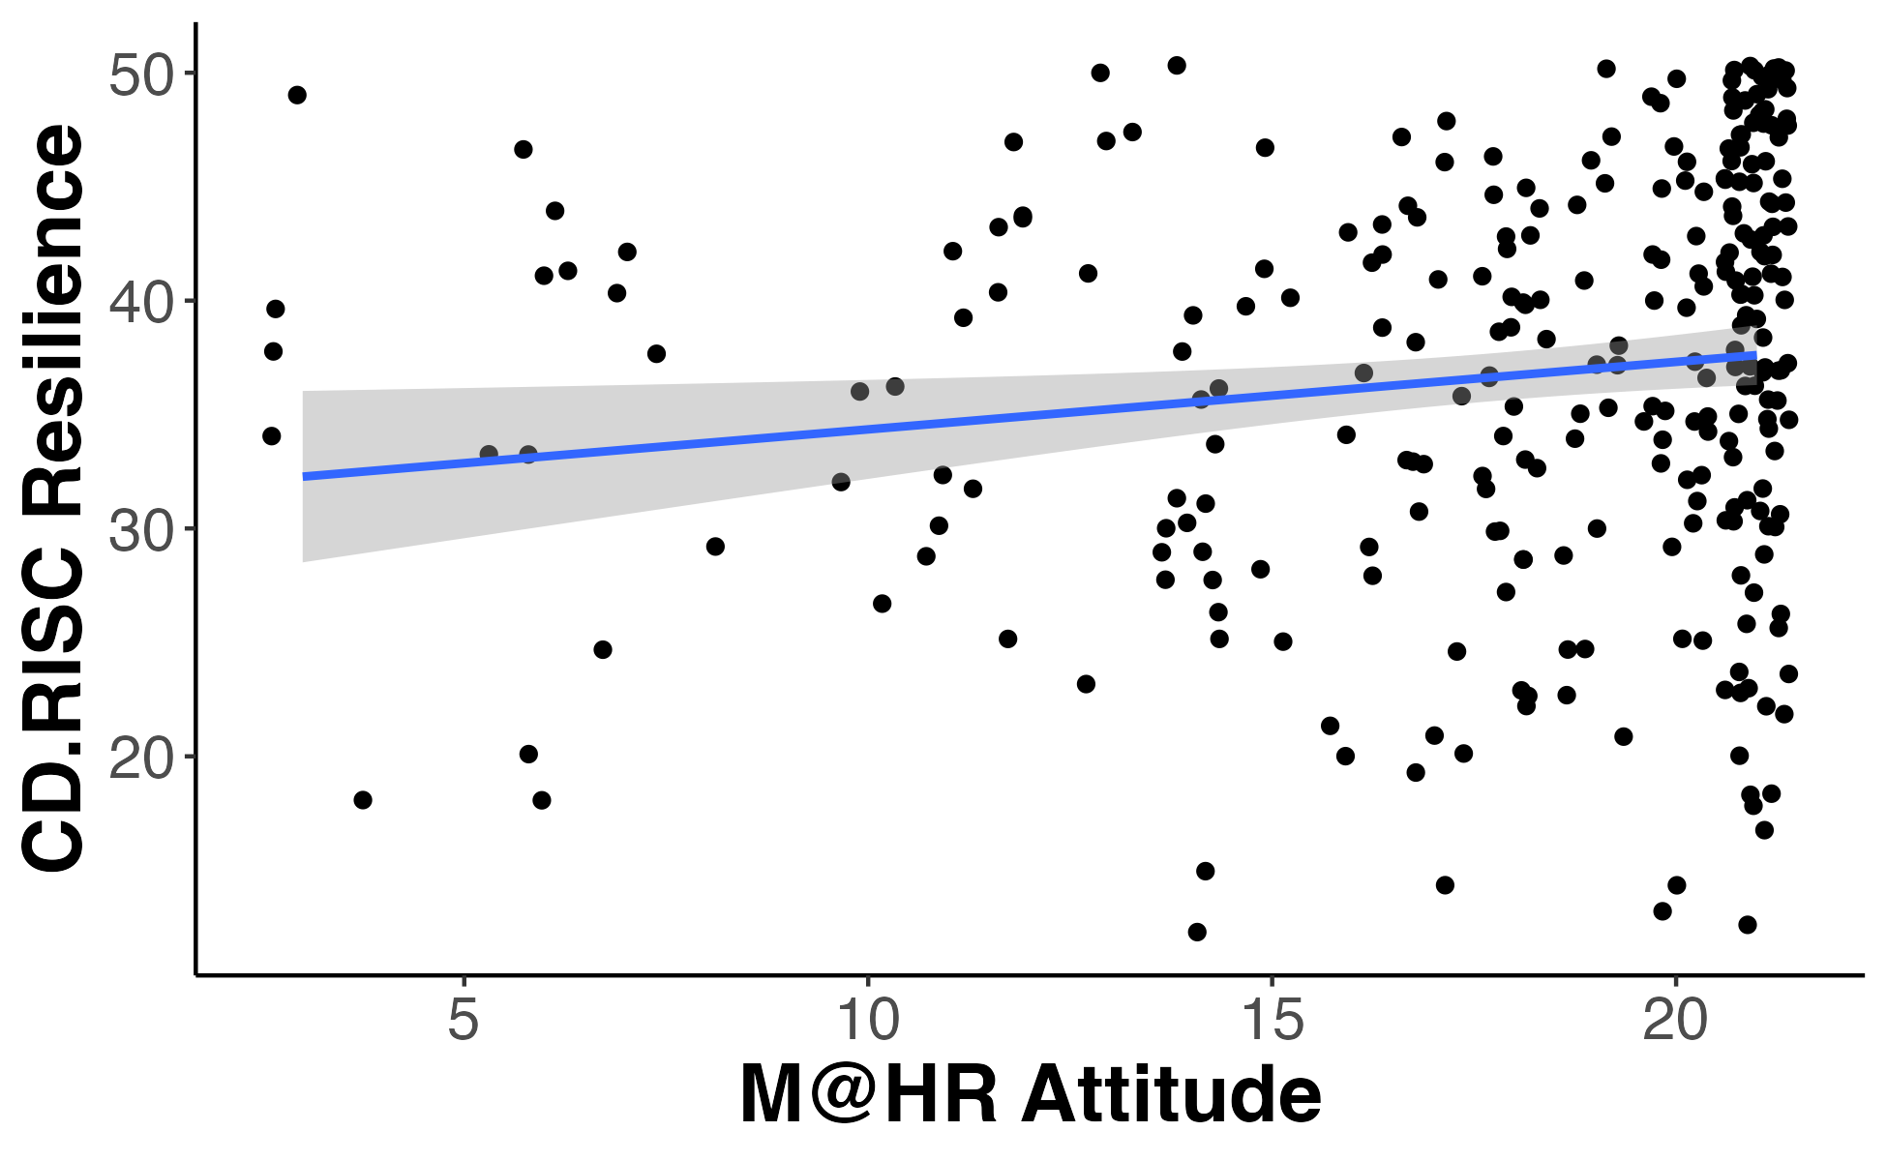
Figure 6: CD-RISC
A.
B.
C.
r = .22***
r = .14*
r = .27***
D.
E.
r = .17**
r = .14*

